Slide 1
FULLSTACK
Backend Programming

Slide 2
Introduction to Go

Slide 3
What is Go ?
Programming language
Developed at Google in the year 2007
Robert Griesemer, Rob Pike, and Ken Thompson.

Slide 4
Advantages of Go Programming
Compilation time is fast
Simple, concise, and safe
Support for environment adopting patterns similar to dynamic languages

Slide 5
Environment Setup
Download on https://golang.org/dl/
Download Editor https://code.visualstudio.com/Download
Setup Configuration on: 1. Ubuntu: - sudo tar -C /usr/local -xzf go$VERSION.$OS-$ARCH.tar.gz 2. Windows : - Download mingw64 Terminal - echo "export GOPATH=$HOME/folder_name" >> .bash_profile - source .bash_profile
Getting started: mkdir –p $GOPATH/src/gitlab.com/your_account/project_name

Slide 6
Basic Syntax

Slide 7

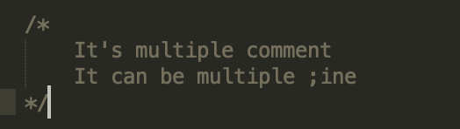
Basic Syntax - Comment
Single line comment
Multi line comment

Slide 8


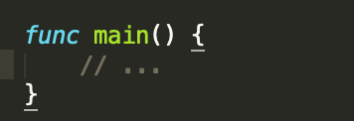
Basic Syntax
Package declaration
Import Statement
Function declaration

Slide 9
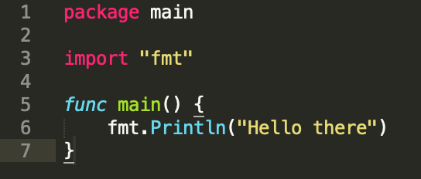
Basic Syntax
Compile file: go run file_name

Slide 10

Let’s try !
Print this output with basic syntax:
Today is a great day. I’m learning programming

Slide 11
Data Type

Slide 12
Data type
Boolean types
- True or false
Numeric types
- Integer , Float
String types
Derived types

Slide 13
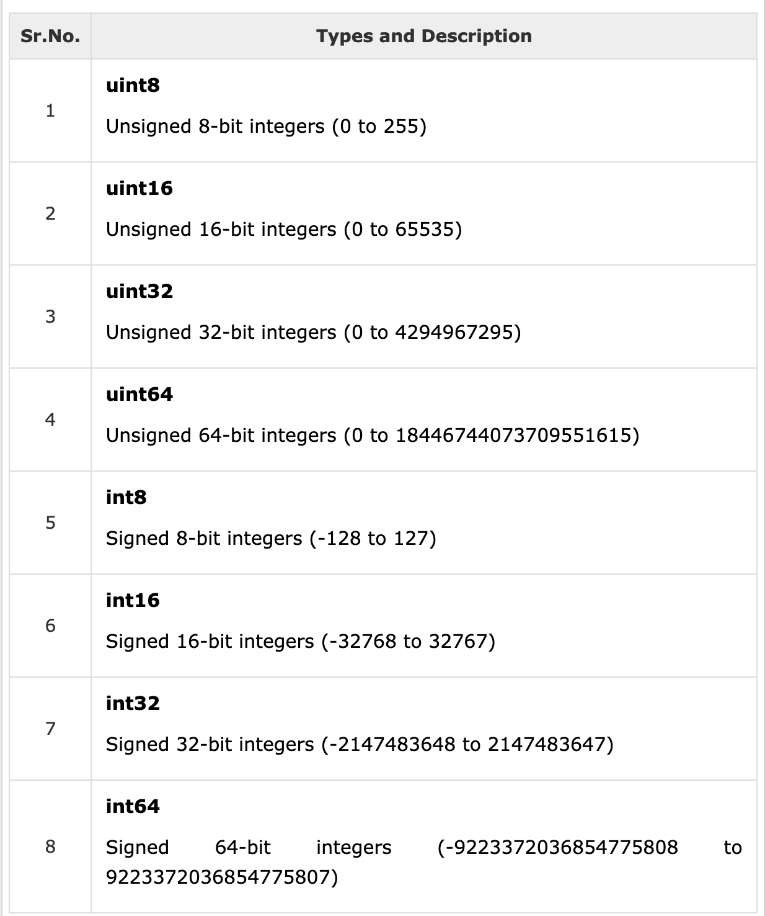
Integer Types

Slide 14
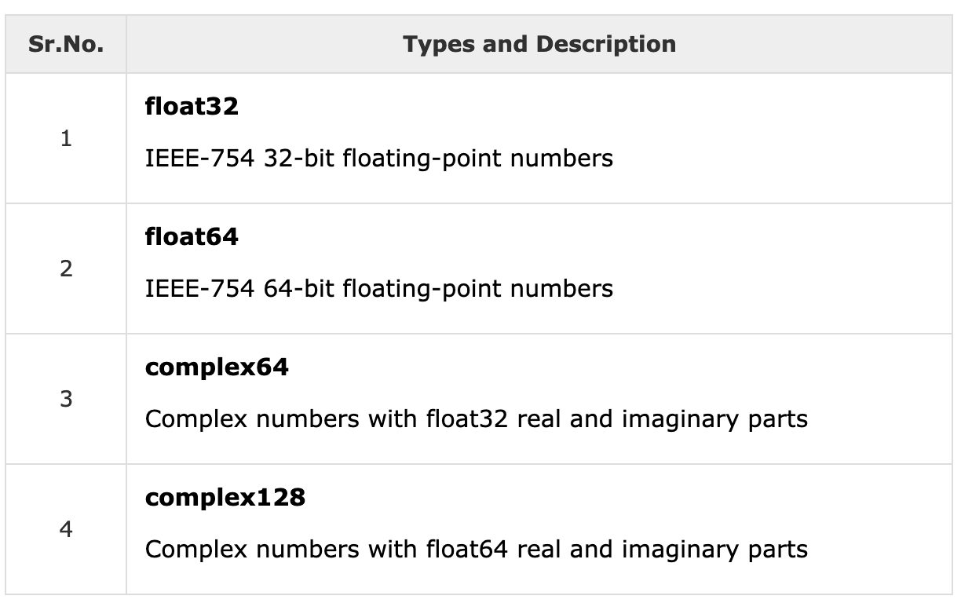
Floating Types

Slide 15
Variables

Slide 16
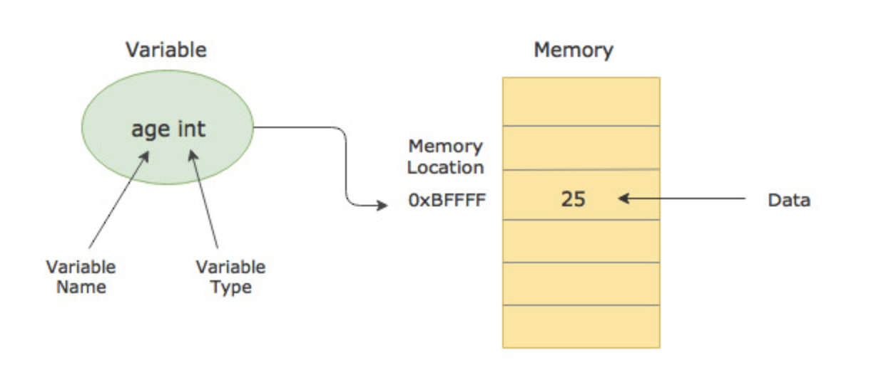
Variables

Slide 17
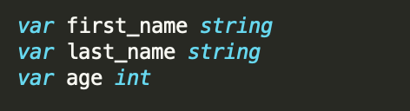
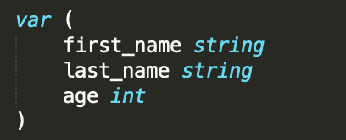
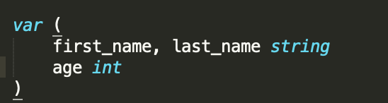
Variables
Declare variables
Declare multiple variables
Declare combine multiple variables

Slide 18
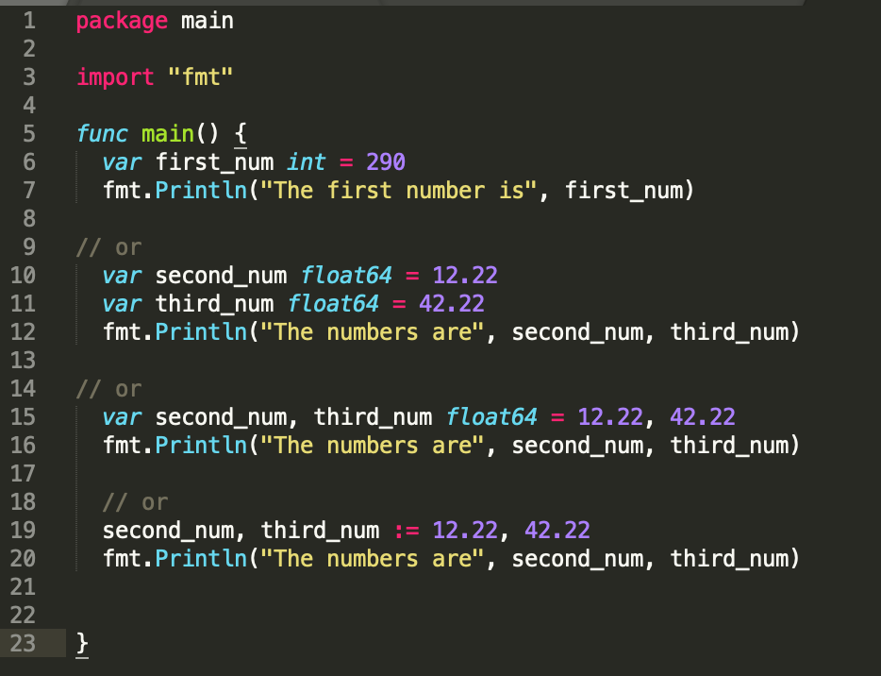
Variables

Slide 19
Values

Slide 20
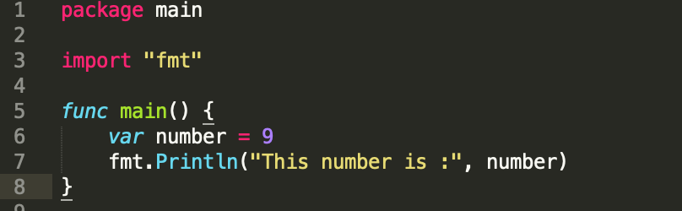
Values

Slide 21
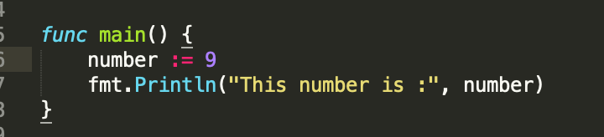
Values – Short Declaration
Short declaration syntax := operator For example: var number int = 9 is number := 9

Slide 22
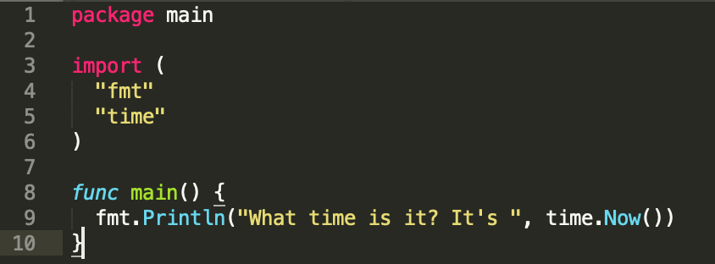
Values

Slide 23
Let’s try !
Put the value of your name, and print it !
result : “Your_name” loves coding

Slide 24
Constants

Slide 25
Constants
Unchanging values such as: - 7 - 1.23 - true - hi - etc

Slide 26
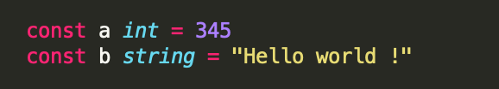
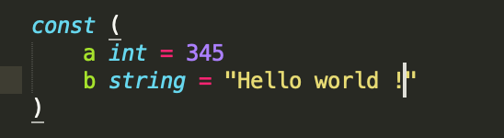
Constants - Declaration
Single declaration
Multiple declaration

Slide 27
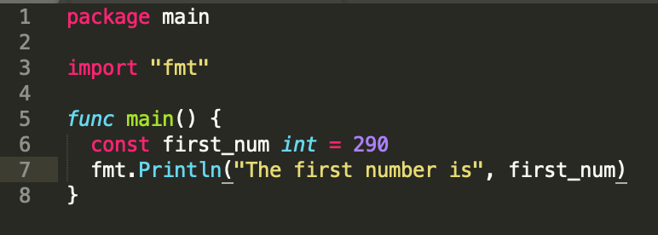
Constants

Slide 28
Let’s try !
Give type of these values with using var and const :
4.567
50
Hi
true

Slide 29
If Statement

Slide 30
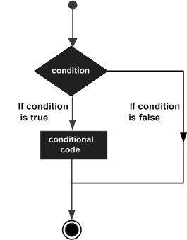
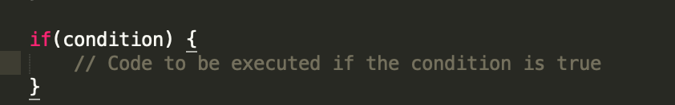
If Statement

Slide 31
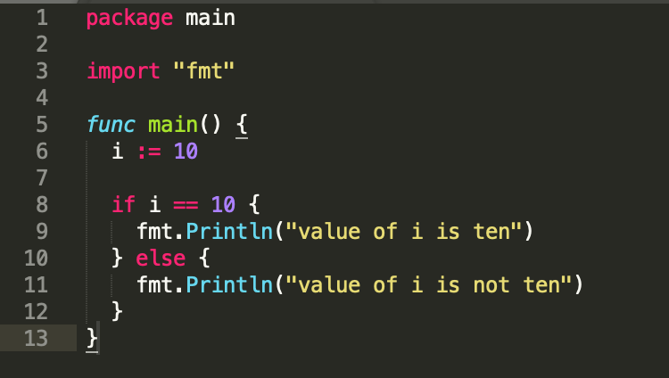
If Statement

Slide 32
Let’s try !
Print the value it’s number 5, if a is equal to 5, and print it if it’s not equal to 5

Slide 33
Summary
Basic Syntax
Values
Data types
Variables
Constants
If Statement

Slide 34


